Slide 1
Sharepoint assistant
On demand helpdesk in your sharepoint portal
Saulius Laurinaitis
Thomas Daly
Stephan Kitzler-Walli
Andreas Krüger

Slide 2
Bots for the rescue
SPFx Extension as bot host
SharePoint Context and Current User passed to the bot
Proactive bot tries to suggest what you would like to create based on context
Workload is pushed to Azure Queue and Web Jobs start their work
Results are pushed to queue and Azure Function sends it to the chat session

Slide 3
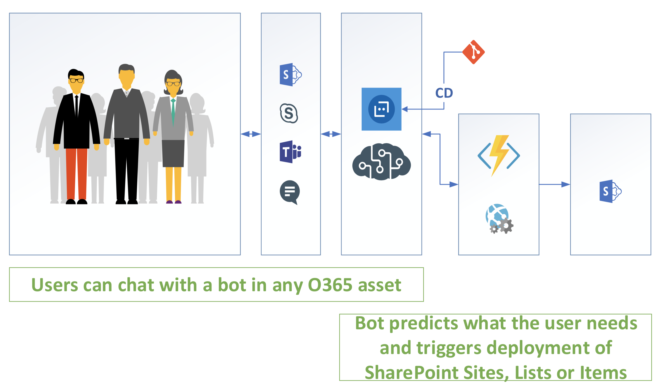
Architecture

Slide 4
DEMO
Create a new site in a few simple steps

Slide 5
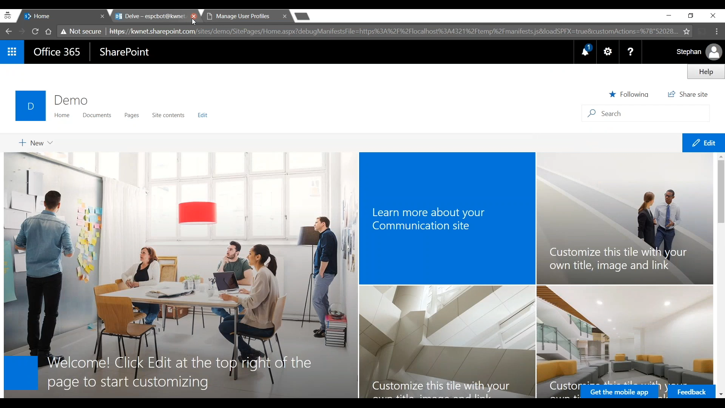

Slide 6
Integration across office 365 / Azure
Utilize Bot Framework
Interactions throughout all channels
Teams
Skype
SharePoint
…

Slide 7
Technologies
Bot Framework (QnA Builder, NodeJS)
Azure Functions / Azure Webjobs
Azure Queues
Modern Communication Site
SPFx Extensions
Office UI Fabric
React
PnP Sites Core
PowerShell
…

Slide 8
Business value
Support for end users on daily tasks
Effort saving based on predictions
Suggestive support service (based on what’s possible)
Faster onboarding
Less support tickets for IT department

